Slide 1


INTRODUCTION TO MICROSOFT COPILOT

Slide 2
MODULE AGENDA

Slide 3

Module Agenda
What is Microsoft CoPilot?
CoPilot vs. CoPilot Pro vs. CoPilot 365
How does CoPilot work?
Live Demo: Microsoft CoPilot Capabilities
© All rights reserved for Dr. Ryan Ahmed @Stemplicity Inc.

Slide 4
MICROSOFT COPILOT 101

Slide 5
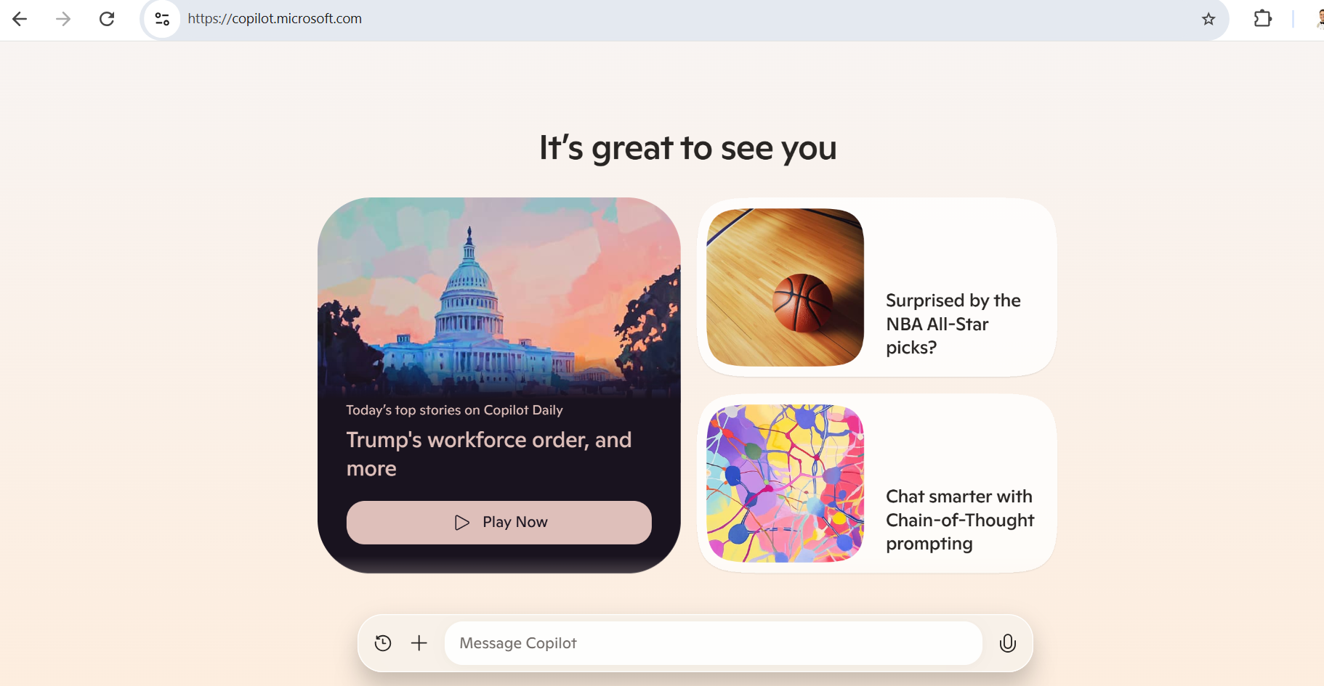

What is Microsoft CoPilot?
Microsoft Copilot is an AI-powered assistant designed to help you with a wide range of tasks.
It leverages advanced AI models, like GPT-4, to provide support in various areas such as productivity, information synthesis, and more.
Link: https://copilot.microsoft.com/
© All rights reserved for Dr. Ryan Ahmed @Stemplicity Inc.

Slide 6
Microsoft CoPilot Capabilities
Content Creation: Drafts, rewrites, and improves text in Word, Outlook, and other apps.
Data Analysis: Analyzes data, summarizes trends, and creates visualizations in Excel.
Task Automation: Automates workflows, schedules tasks, and organizes meetings in Outlook and Teams.
Meeting Support: Summarizes discussions, action items, and generates notes in Teams.
Presentation Tools: Builds PowerPoint slides, suggests visuals, and creates speaker notes.
App Integration: Pulls and uses data across Word, Excel, PowerPoint, Teams, and SharePoint.
Knowledge Retrieval: Searches files and provides contextual insights using natural language.
Coding Assistance: Generates code snippets, debugs, and helps in Visual Studio.
© All rights reserved for Dr. Ryan Ahmed @Stemplicity Inc.

Slide 7
MICROSOFT COPILOT Vs. COPILOT PRO Vs. MICROSOFT 365 COPILOT

Slide 8
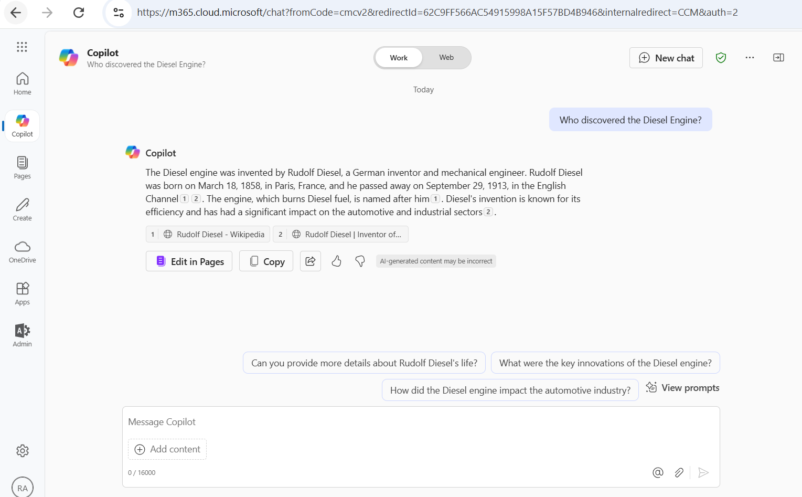
What is Microsoft CoPilot? (Free)
Microsoft Copilot is a free AI service that brings ChatGPT technology to the masses.
Copilot can assist in searching the web, creating content, generating images, and answering complex questions or queries.
Feature | Microsoft Copilot (Free Version)
Get credits for AI usage | Limited usage
Get real-time results | ✔
Preferred access to the latest models | Non-peak times
Try Copilot Voice | Limited Usage
Get early access to experimental AI features | Not available
Create images with AI | 15 boosts per day
Multiple devices and platforms | ✔
Unlock Copilot in select Microsoft 365 apps | Not available
© All rights reserved for Dr. Ryan Ahmed @Stemplicity Inc.

Slide 9
What is Microsoft CoPilot Pro? (Paid)
A Microsoft ​​​​​​​​​​​​Copilot Pro subscription boosts your creativity and productivity by providing priority access to the latest AI models that give you quicker response times, and early access to new features.
Feature | Microsoft Copilot Pro | Microsoft Copilot Free Version
Subscription Cost | CAD $27.00 user/month | Free
Get credits for AI usage: Receive fresh AI credits at the start of each month to use Copilot in Microsoft 365 apps. | Extensive usage | Limited usage (includes Designer only)
Get real-time results: Copilot uses advanced AI grounding to provide up-to-date information. | ✔ | ✔
Preferred access to the latest models: During peak usage times, free users may have limited access. | Preferred Access | Non-peak times
Try Copilot Voice: Engage in natural, spoken conversations with the latest AI technology. | Extended Usage | Limited Usage
Get early access to experimental AI features: Be the first to experience new AI features. | ✔ | Not Available
Create images with AI: Transform your imagination into images and use boosts for faster creation. | 100 boosts per day | 15 boosts per day
Multiple devices and platforms: Use Copilot on the web, in the mobile app, and in Windows and Microsoft Edge. | ✔ | ✔
Unlock Copilot in select Microsoft 365 apps: Use Copilot in Word, Excel, PowerPoint, OneNote, and Outlook. | ✔ | Not Available
© All rights reserved for Dr. Ryan Ahmed @Stemplicity Inc.
Link: https://www.microsoft.com/en-ca/store/b/copilotpro

Slide 10
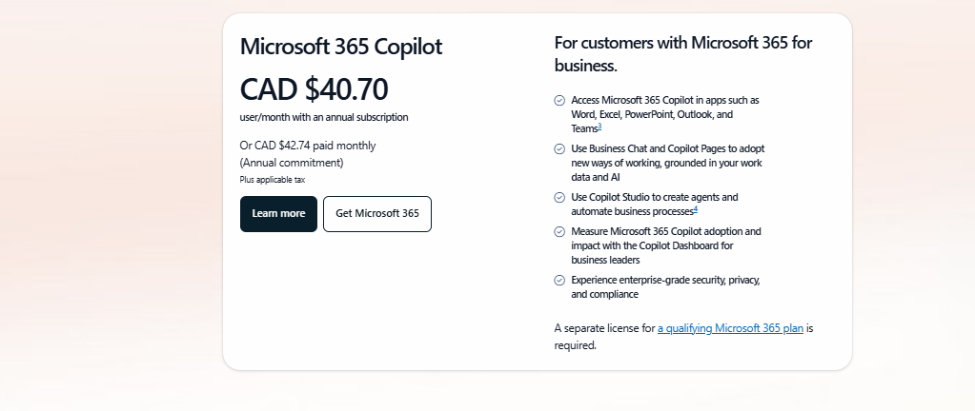
What is Microsoft 365 CoPilot? (paid)
Microsoft 365 Copilot is an AI-powered productivity tool that has real-time access to both your content and context in the Microsoft Graph.
This means it generates answers anchored in your business content — your documents, emails, calendar, chats, meetings, contacts and other business data
© All rights reserved for Dr. Ryan Ahmed @Stemplicity Inc.

Slide 11
Microsoft CoPilot, CoPilot Pro, & CoPilot 365
Feature | CoPilot (Free) | CoPilot Pro (Paid) | CoPilot for M365 (Paid)
Cost | Free | Paid | Paid
Target Audience | Individuals | General users | Enterprise and Teams
Model Access | Standard GPT-4 & web grounding | Priority model access | Priority model access + CoPilot in M365
Integration | Not integrated | Integrated in Office tools like Word, Excel, PPT | Integrated with Teams, Graph data (emails, chats, documents)
Customization | Not available | Make your own using CoPilot GPT Builder (additional fee) | Make your own using CoPilot Studio (additional fee)
© All rights reserved for Dr. Ryan Ahmed @Stemplicity Inc.

Slide 12
HOW DOES COPILOT WORK?

Slide 13
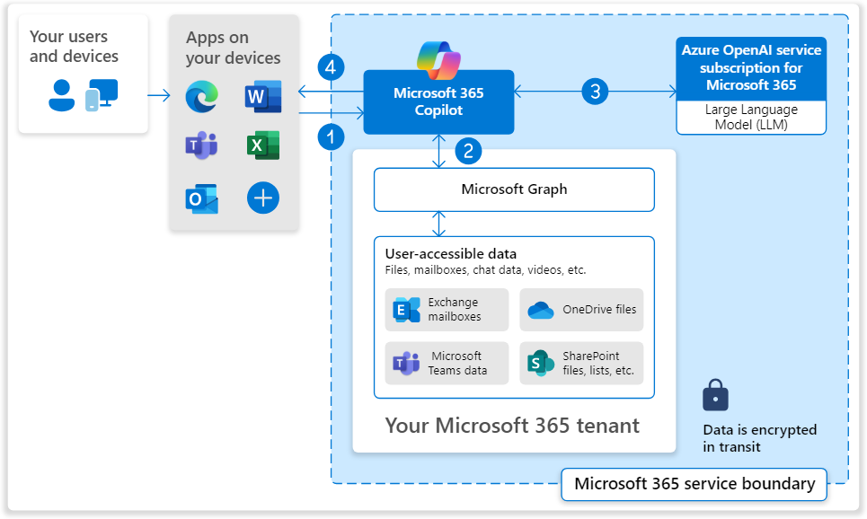
How does CoPilot 365 Work?
User inputs a prompt in Copilot
Copilot preprocesses the prompt using grounding, enhancing relevance.
Grounded prompt is sent to the LLM, which generates a contextually relevant response.
Copilot delivers the response back to the user.
© All rights reserved for Dr. Ryan Ahmed @Stemplicity Inc.

Slide 14
COPILOT LIVE DEMO

Slide 15
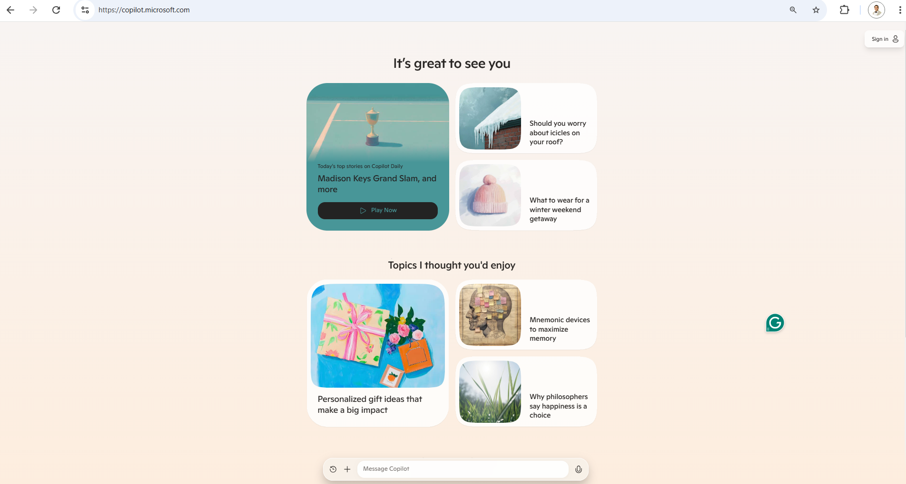
Live Demo
🔗 Click here to explore CoPilot CoPilot Signup
💡 Click here for AI Prompts Explore Prompts
© All rights reserved for Dr. Ryan Ahmed @Stemplicity Inc.

Slide 16
Thank you!

